Slide 1
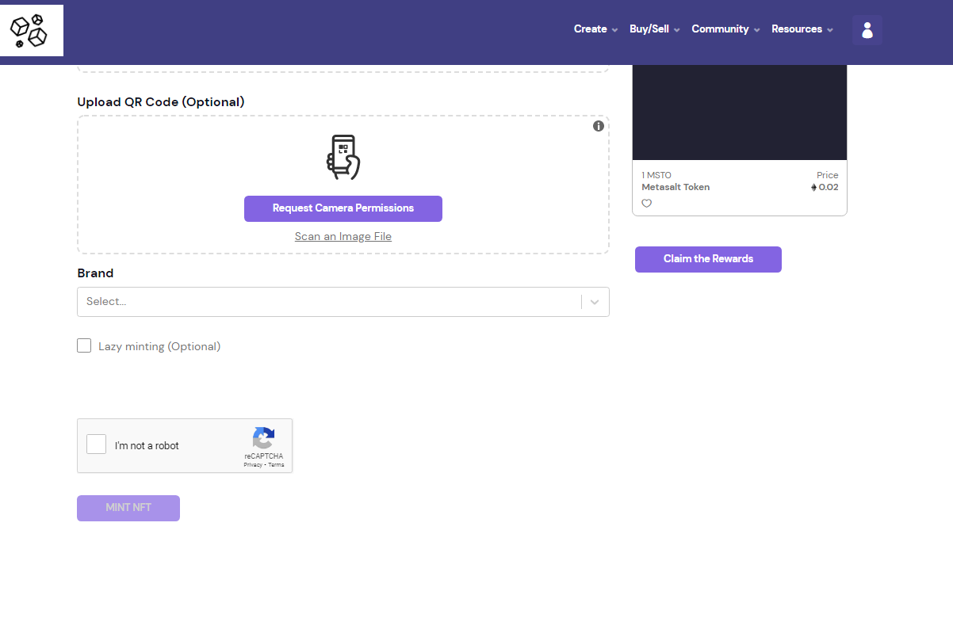
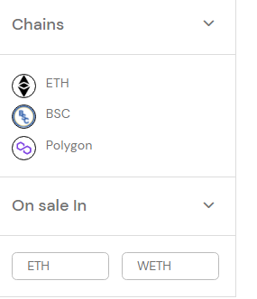
Price METASALT TOKEN

Slide 2
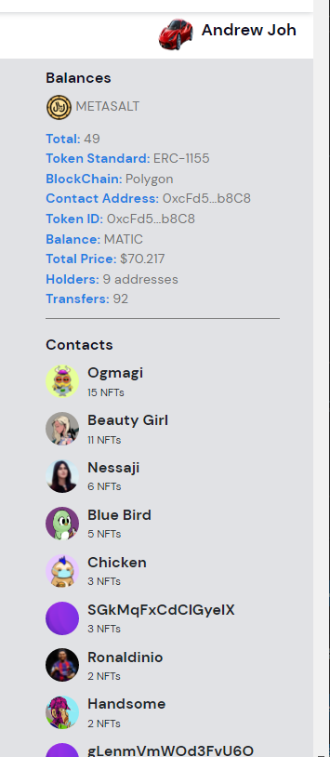


OLD dashboard
NEW dashboard
Account address
Sum = MSToken Rewards (uniswap)
+ ∑(NFT eth price (owned and onsale))
+ ∑ (NFT eth price (owned and onsale))
+ ∑ (NFT eth price (owned and onsale))
Andrew Joh
Contract Address: 0f4x00…
Total Value: $546
MetaSalt Tokens: 2,324
NFT Owned: 49
Lazy Mint: 34
BSC: 5
Polygon: 5
Ethereum: 5
NFT On Sale: 15
BSC: 5
Polygon: 5
Metal Watch Collection
Shoes Collections
Nike (0faf87913 …
Adidas (0f3400 ..
New Balance (0fxxx
Ethereum: 5
ERC20 claimed rewards
List Dropdown
Total NFTs for account
Moralis DB
List by Chain
Moralis BSC Indexer
Moralis Poly Indexer
List by collection
Moralis eth Indexer
List by NFTs
NFTs on market

Slide 3
Authentication page
User enters in TokenURI
0fxd243…..
Popup cost modal
Token URI
3 Metasalt tokens
Authentication Cost

Slide 4
Authentication page
0fxd243…..
Wallet information
Check if Metasalt creidts
Token URI
You have 100 Metasalt tokens
Authentication Cost 3 Metasalt
Balance after authentication 97 Metasalt

Slide 5
Authentication page
0fxd243…..
Token URI
QR Code 111112ijfh4f1111
Brand Gucci
Unauthentic!

Slide 6
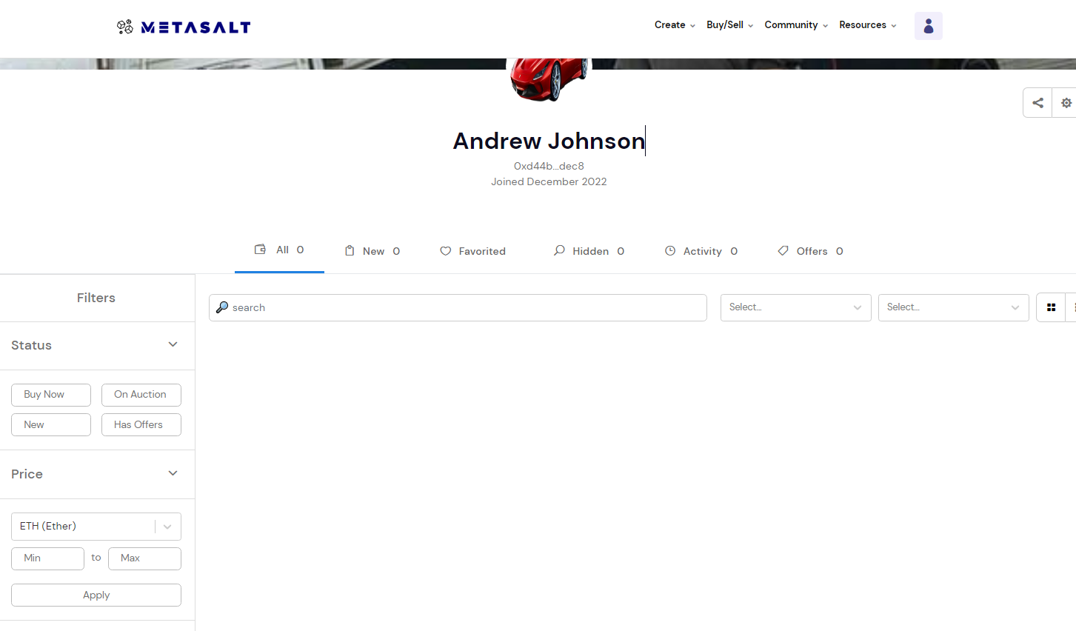

Slide 7
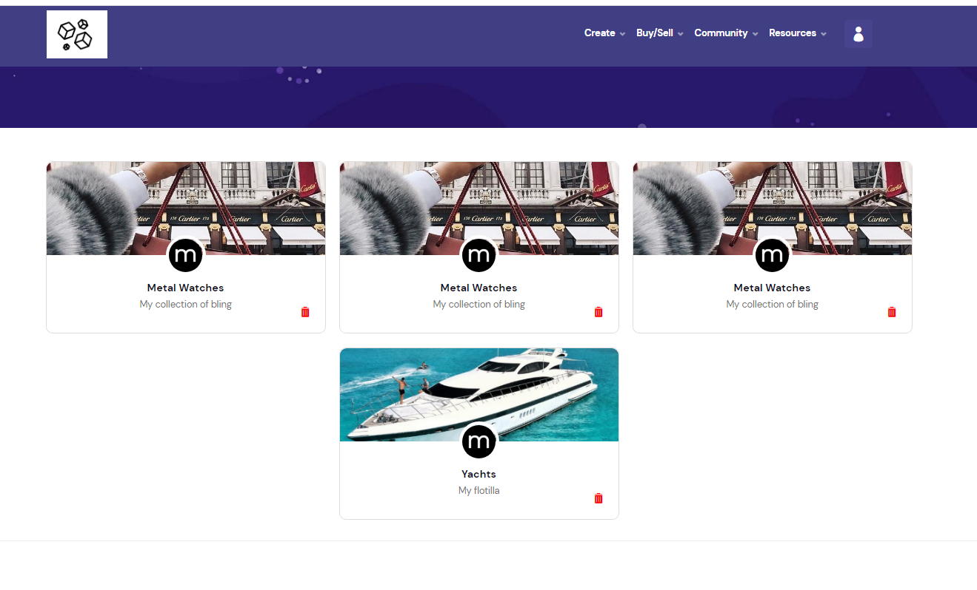

Slide 8
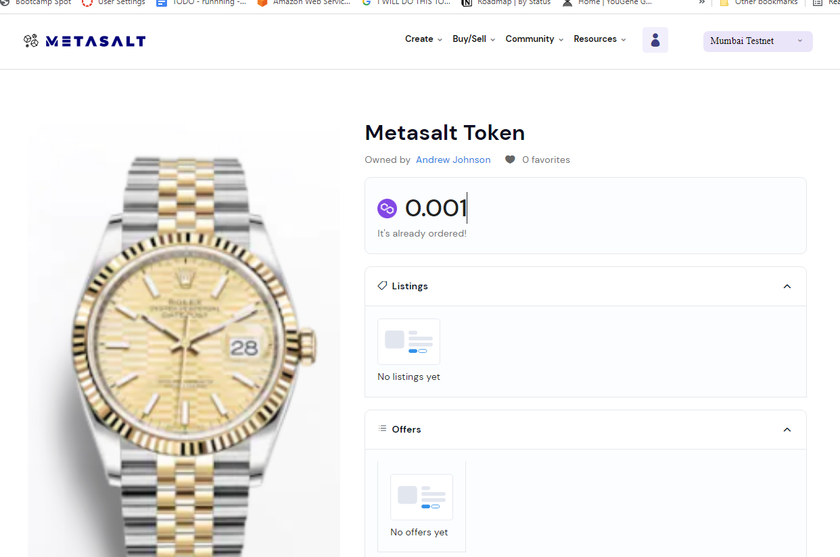
Change price
Stop sale

Slide 9
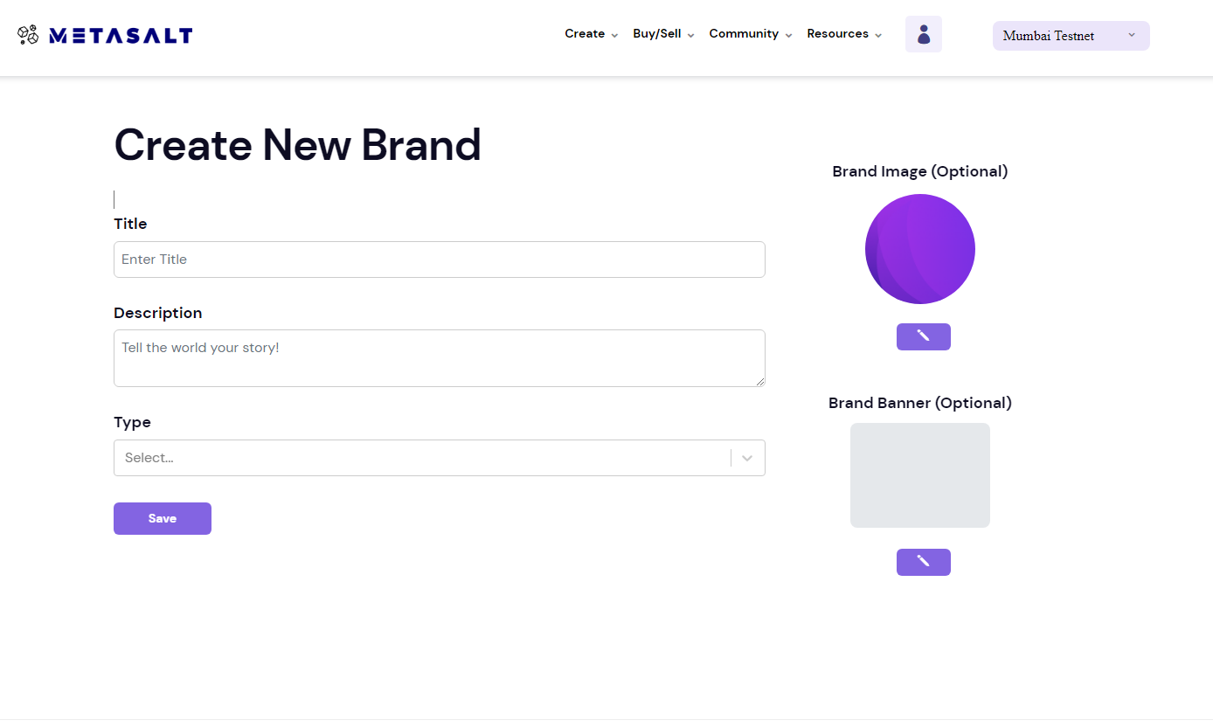
Your Brands
Rolex
Gucci
Gulfstream

Slide 10
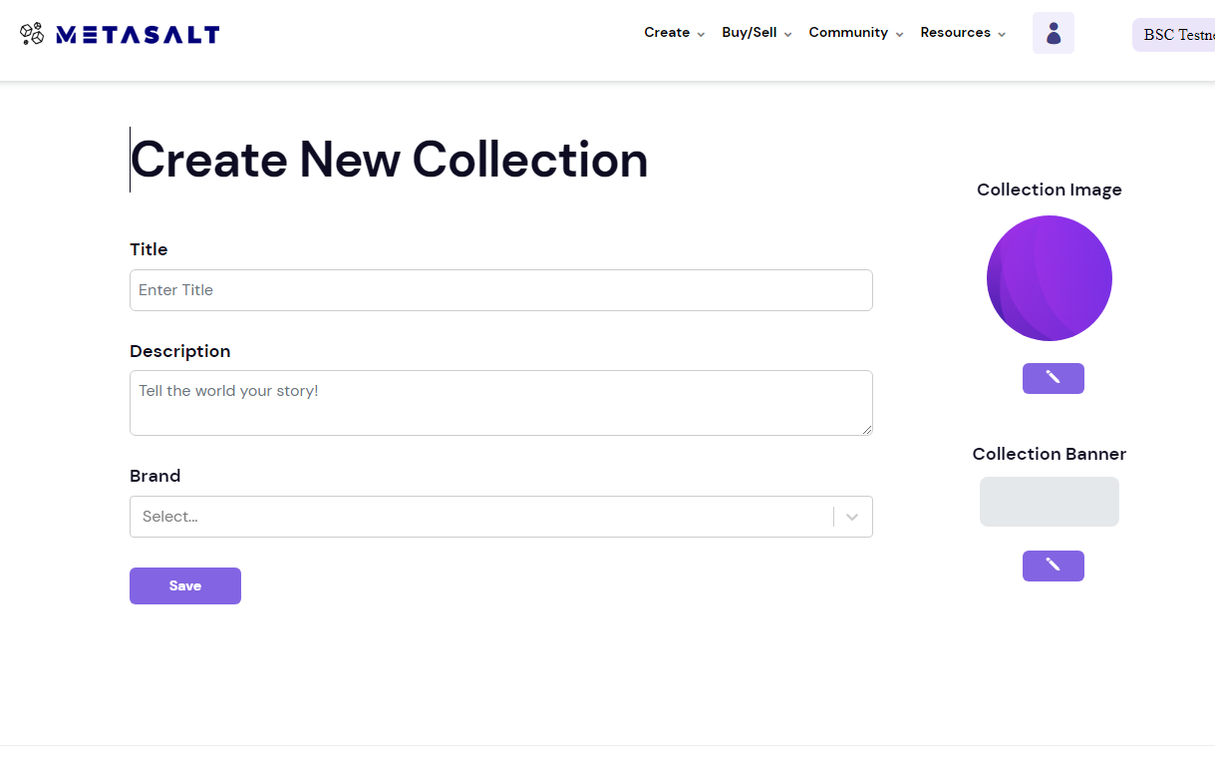
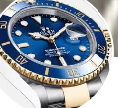
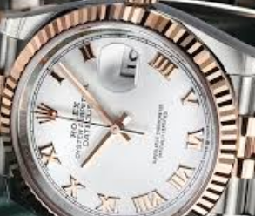
Your Collections Brand collection Image Collection banner
Submariner Rolex
Fluted Rolex

Slide 11
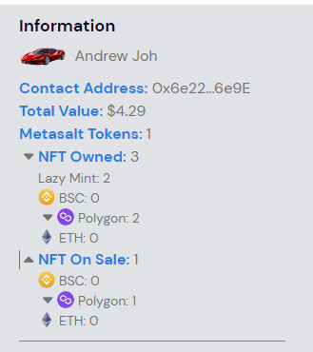

Slide 13
Main Net: 0

Slide 14
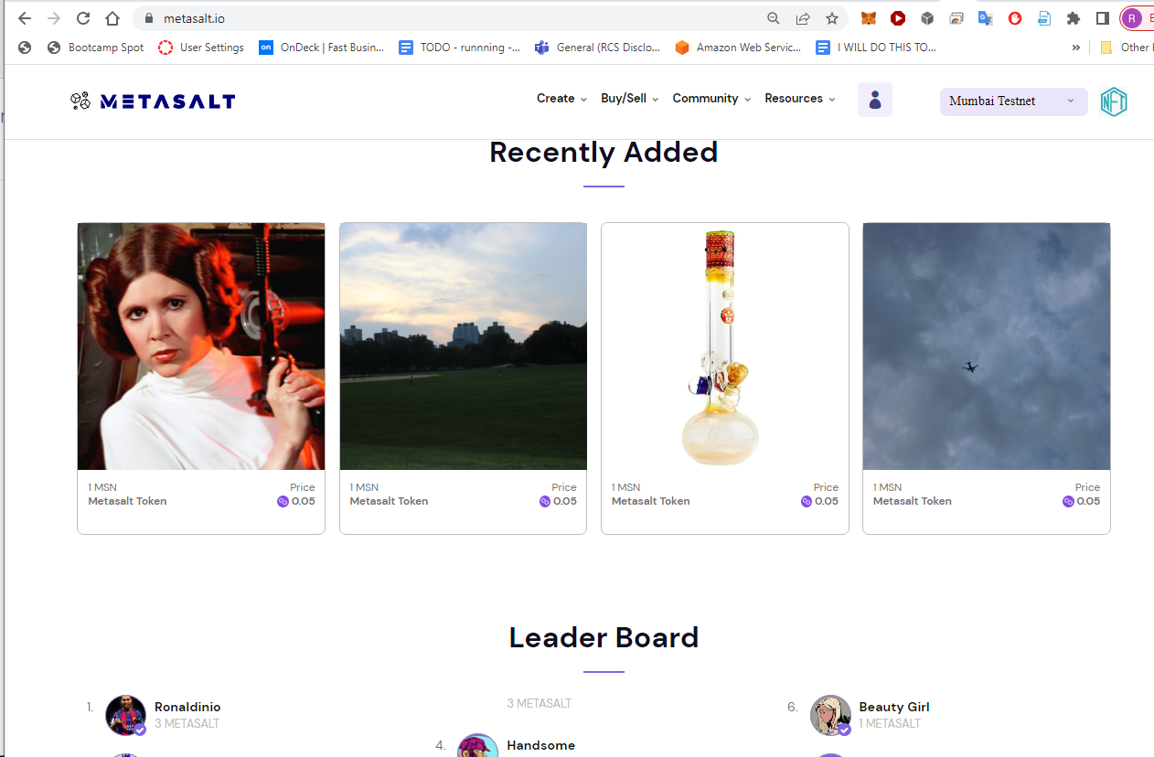
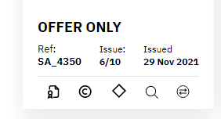

Slide 15
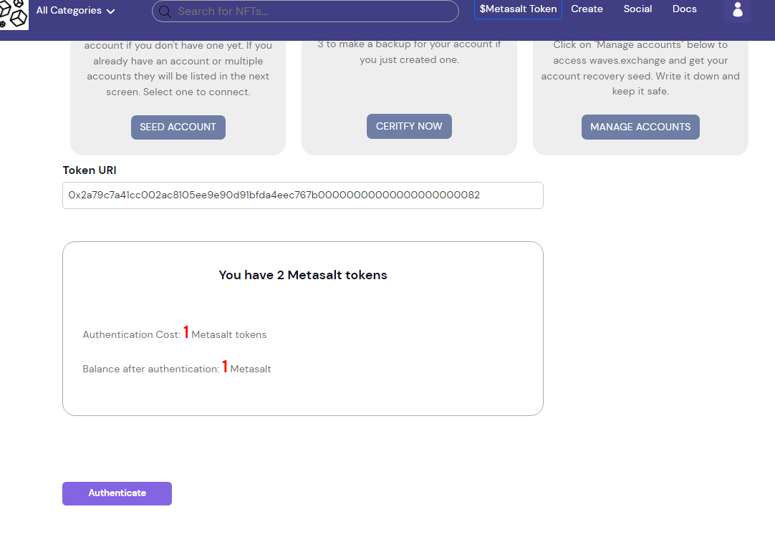



Slide 16
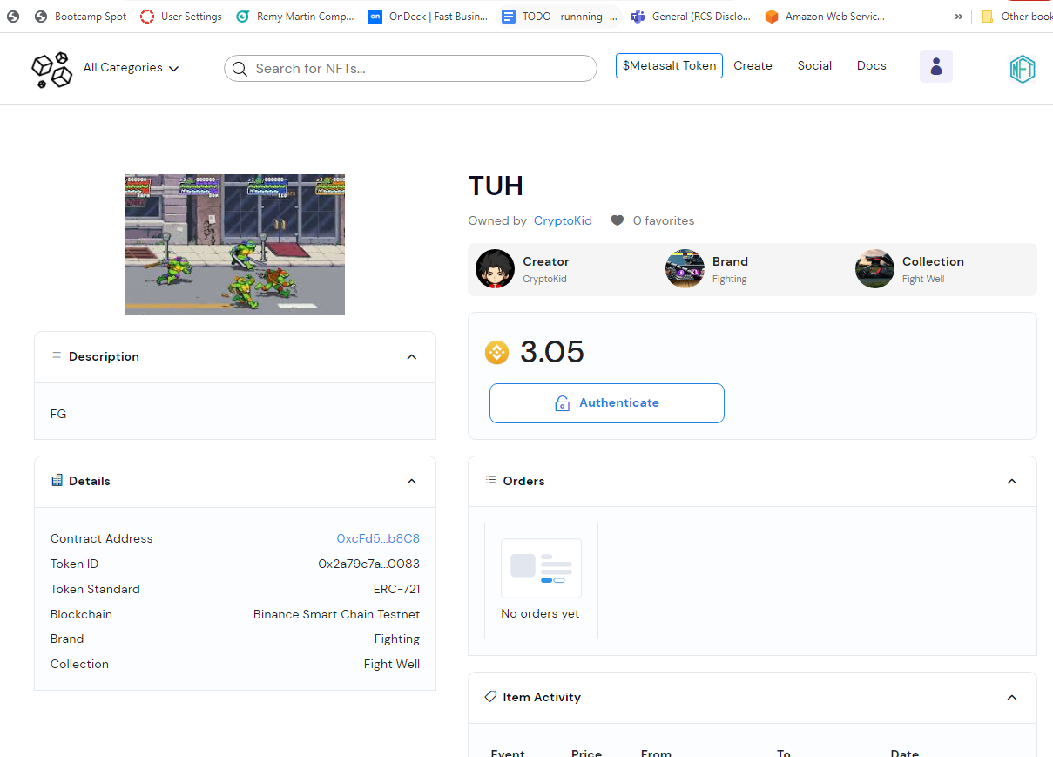

You have authenticated

Slide 17
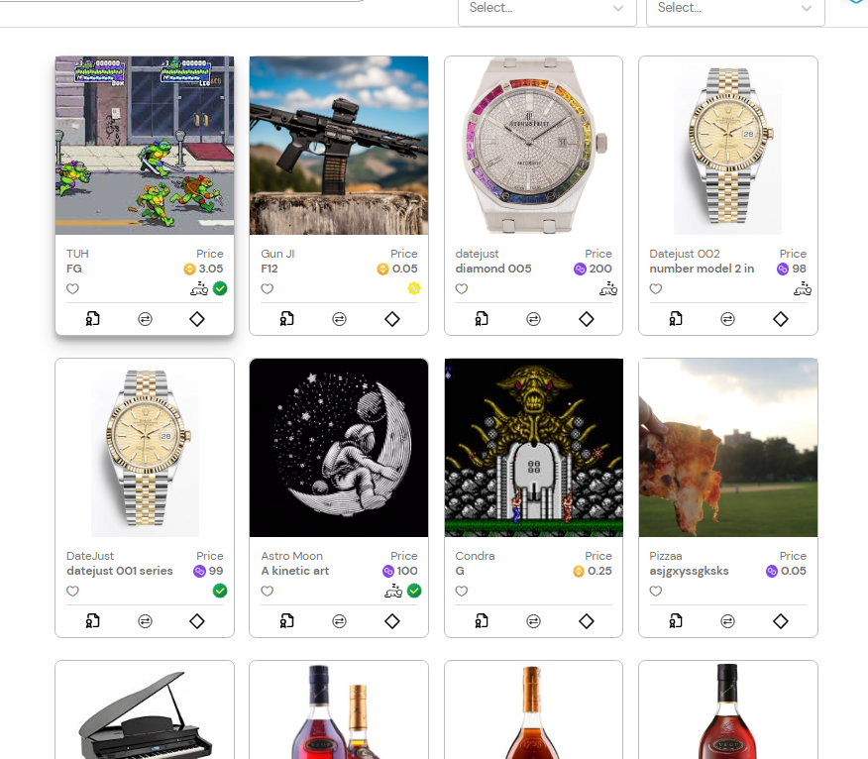
You have authenticated

Slide 18
You have authenticated

Slide 19
